Slide 1
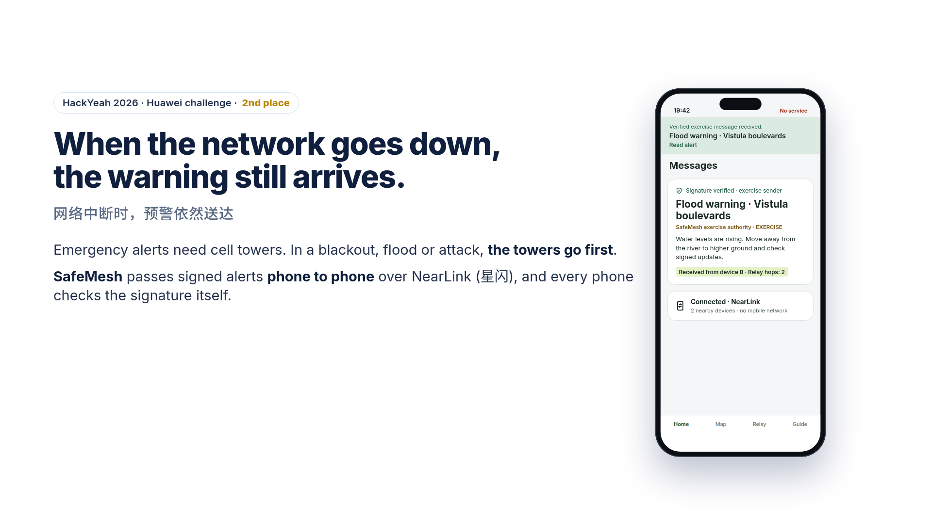
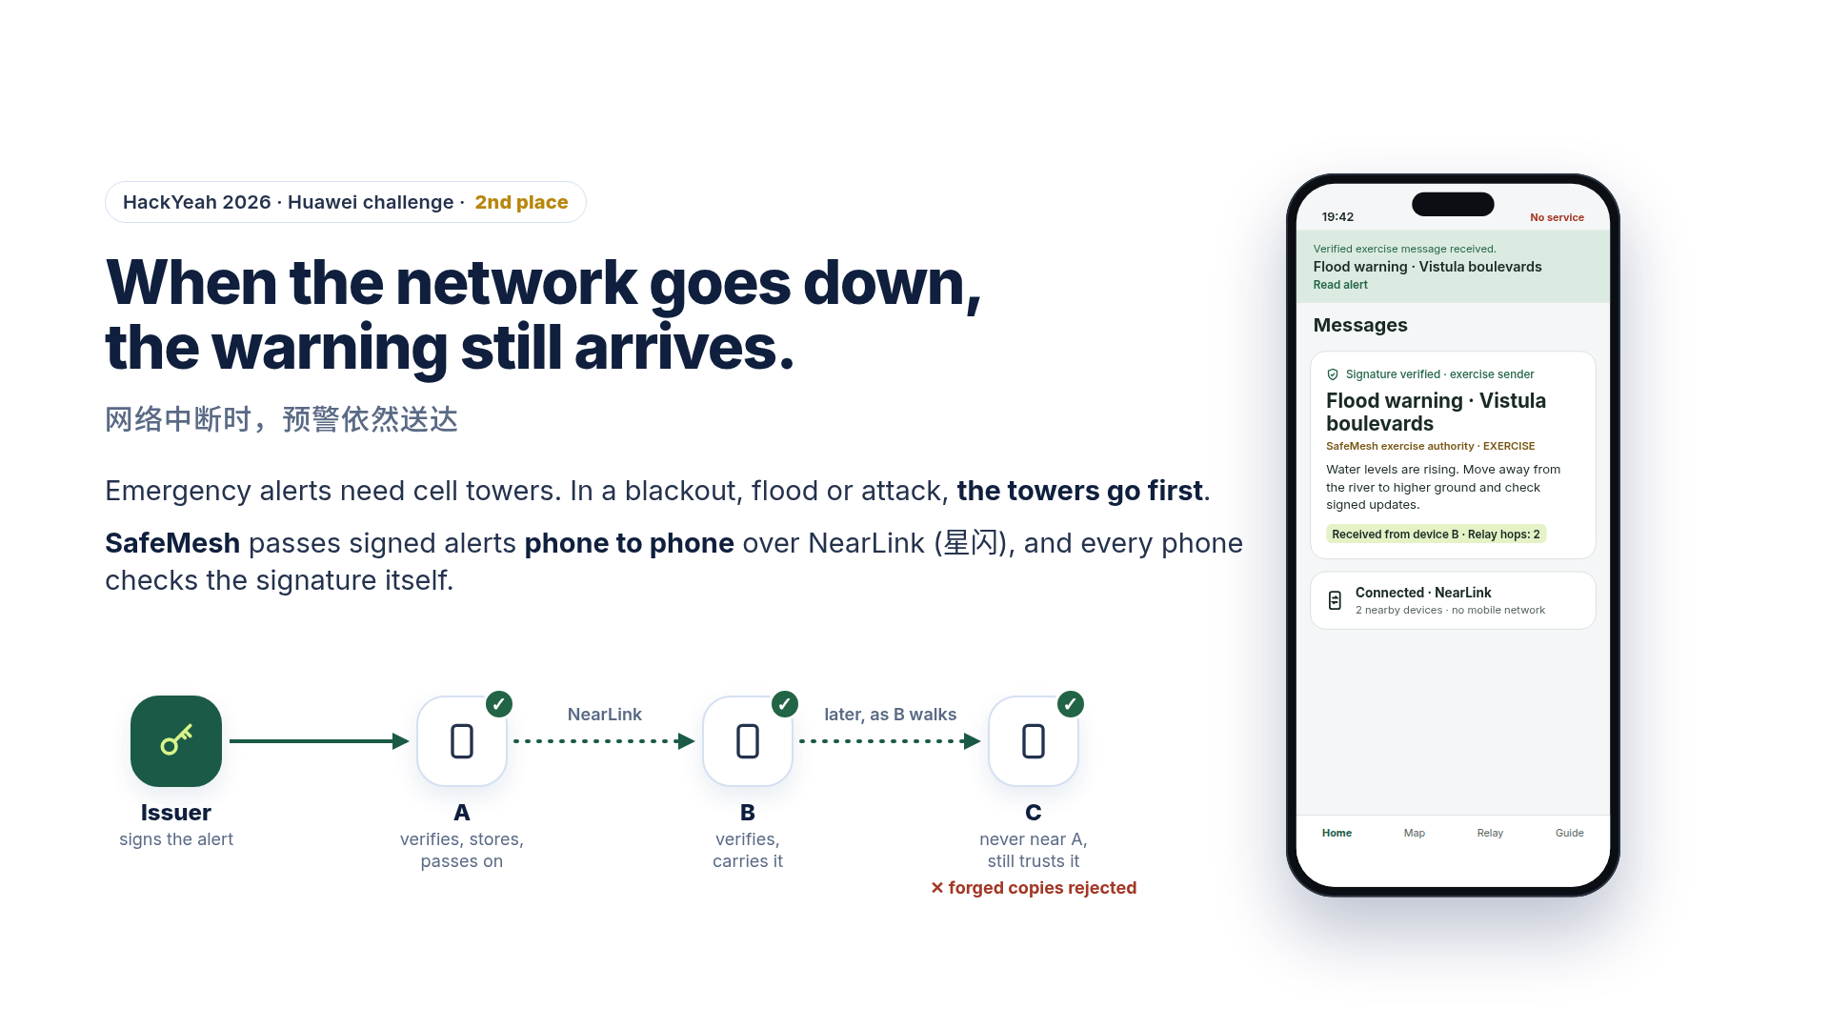
NearLink
later, as B walks
Issuer
A
B
C
signs the alert
verifies, stores,
passes on
verifies,
carries it
never near A,
still trusts it
× forged copies rejected
Notes:
Good morning. Thank you very much for this invitation, and congratulations to all the teams.
My name is Tomasz Kisiel. I am from Carrotly, a software team from Kraków, in Poland. At HackYeah we built SafeMesh, and we won second place in the Huawei challenge.
Imagine a crisis in a city: a flood, a blackout, or an attack. The cell towers go down, and your phone shows "no service". This is exactly the moment when people need a warning. But emergency alerts come through the mobile network. Without towers, they cannot arrive.
SafeMesh solves this. An official issuer signs a warning. Phone A receives it and passes it to phone B over NearLink, with no network at all. Then B walks on, and later passes it to phone C. C was never near the source, but it still gets the warning.
And every phone checks the signature by itself. If someone changes even one letter, the phone rejects the message and does not pass it on. So fake news cannot travel through SafeMesh.

Slide 2
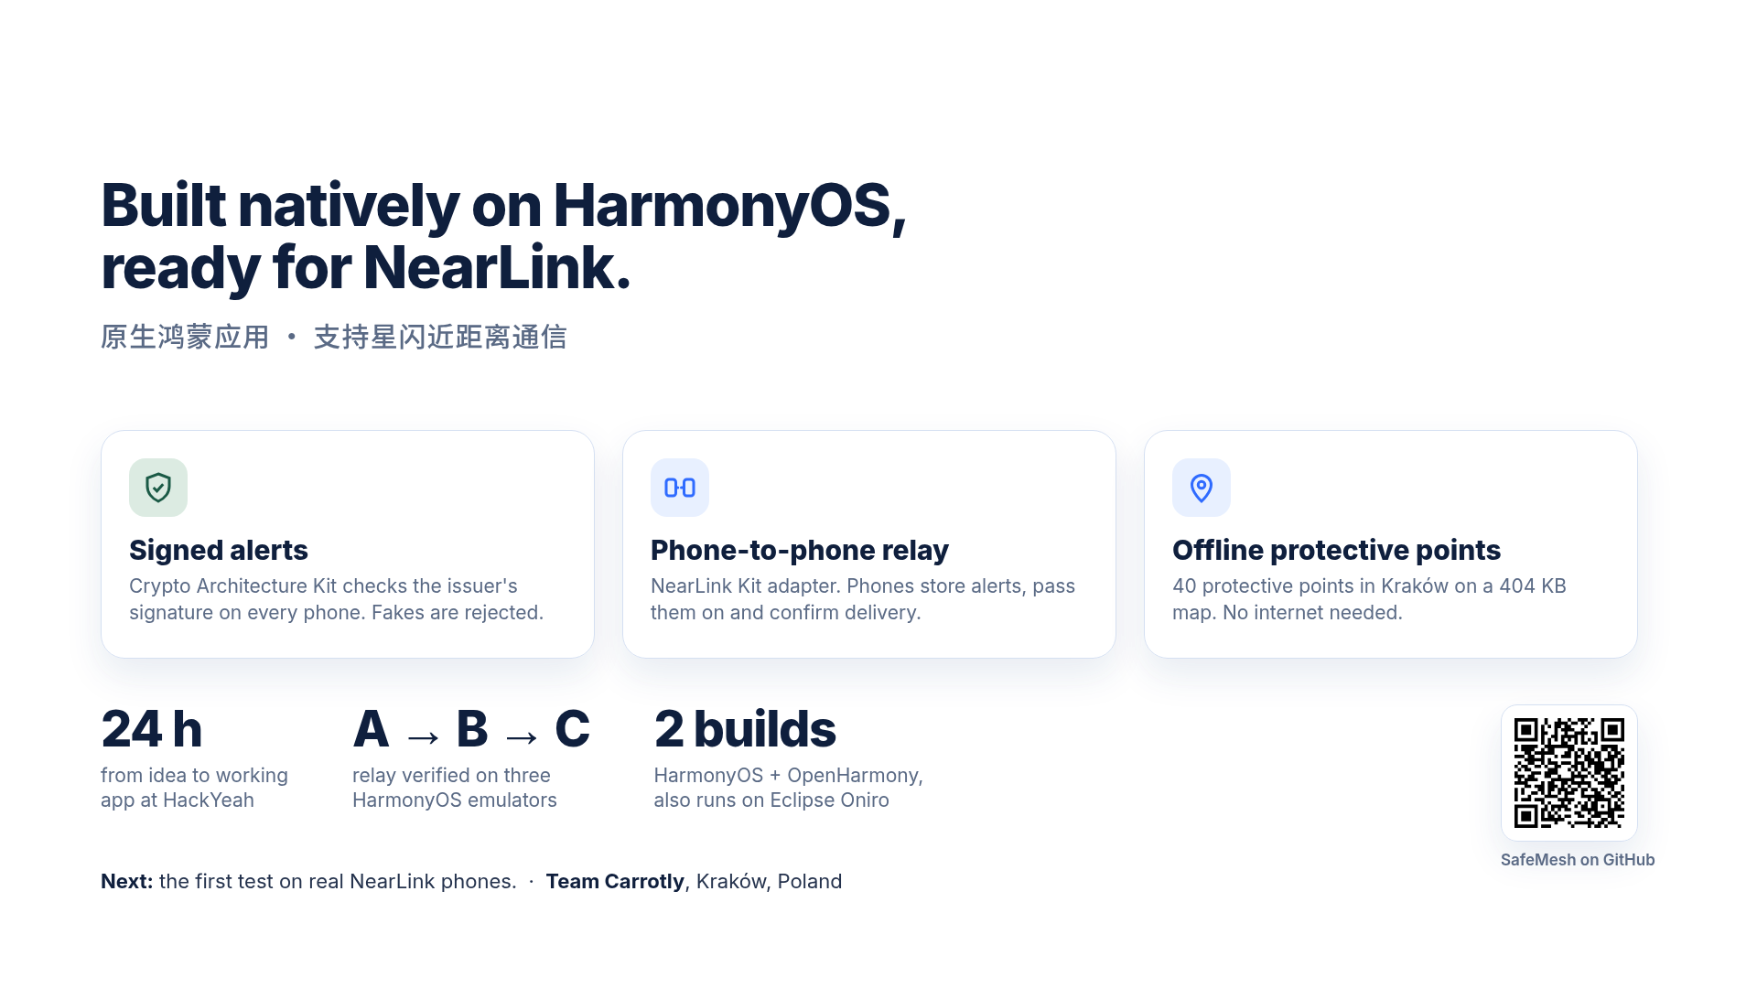
Notes:
We built SafeMesh in twenty-four hours, as a native HarmonyOS app. It has three parts. Signed alerts, checked on the phone with the Crypto Architecture Kit. A phone-to-phone relay, with a NearLink Kit adapter. And an offline map with forty protective points in Kraków.
We showed the full relay, from A to B to C, on three HarmonyOS emulators. The same code also builds for OpenHarmony, and runs on the Eclipse Oniro emulator.
Our next step is the first test on real NearLink phones. We would be very happy to do it together with Huawei.
Your motto this year is "Better Together". This is exactly how SafeMesh works. One phone alone cannot reach everyone. But together, they can.
Thank you very much.

